Slide 1
Estimating Willingness-to-Pay with LLMs
Bridging the Data Availability Gap with Synthetic Contingent Valuation
Trevor Woolley
Sankalpa Ghose
Alina Khindrova
University of California, Berkeley
National University of Singapore
University of Texas at San Antonio
Kasra Rasaee
Bob Fischer
Bloomberg
Texas State University
Society for Benefit-Cost Analysis Conference March 12, 2026

Slide 2
Benefit-cost analyses shouldn’t neglect non-market goods.
“When important benefits and costs cannot be expressed in monetary units, BCA is less useful, and it can even be misleading, because the calculation of net benefits in such cases does not provide a full evaluation of all relevant benefits and costs.
You should exercise professional judgment in identifying the importance of non-quantified factors and assess as best you can how they might change the ranking of alternatives based on estimated net benefits. If the non-quantified benefits and costs are likely to be important, you should recommend which of the non-quantified factors are of sufficient importance to justify consideration in the regulatory decision… In this case, you should also consider conducting a threshold analysis to help decision makers and other users of the analysis to understand the potential significance of these factors to the overall analysis.”
Circular A-4 (2023), p. 10:

Slide 3
To estimate the value of non-market goods, we often need to rely on contingent valuation.
Unfortunately, CV studies are expensive and slow enough that regulatory economists can’t run them to inform their RIAs.
CV can help us value
EXPENSIVE
Large-scale CV surveys require substantial funding for design, sampling, and analysis.
Biodiversity Protection
Water Quality
SLOW
Months or even years before data are available.
Climate Action
Animal Welfare
INFLEXIBLE
The design gets locked in quickly: it’s costly to iterate on survey design or test alternative framings.

Slide 4
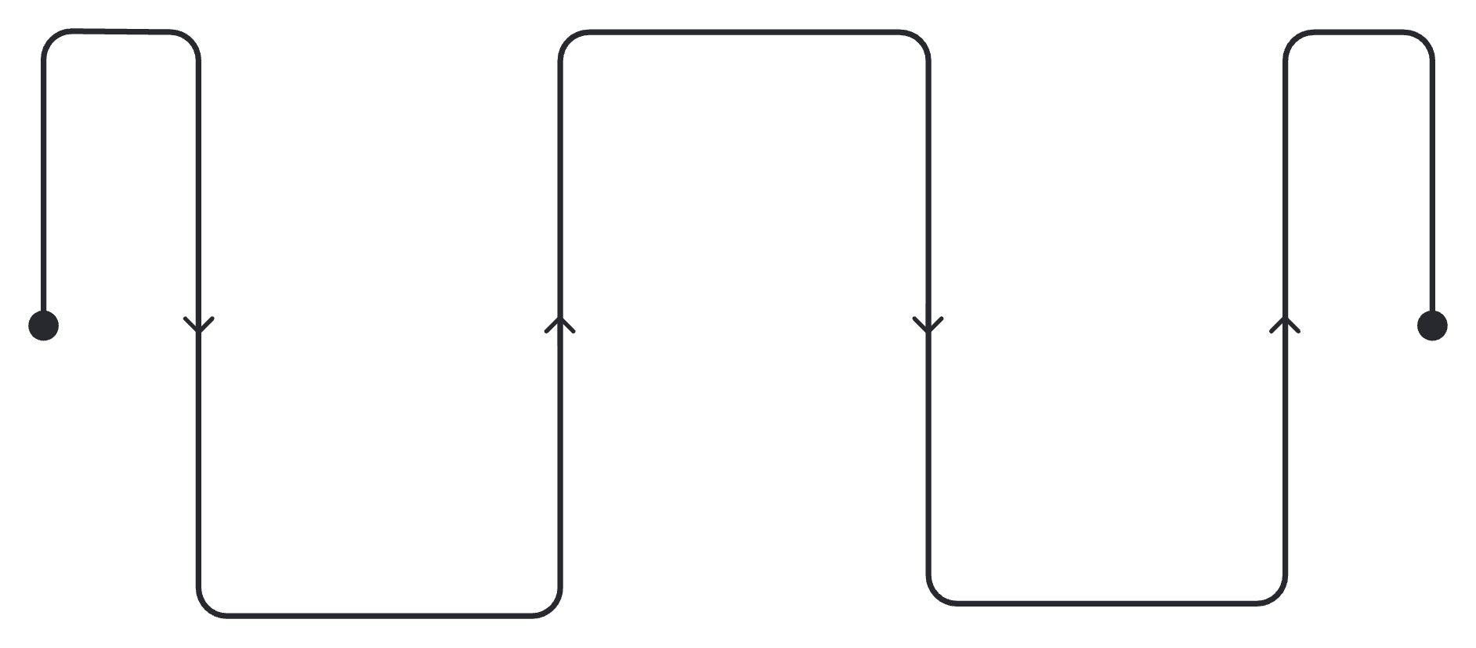
Can LLMs Simulate Contingent Valuation?
Synthetic experiments could allow us to approximate stakeholders’ WTP. In principle, this could be a powerful new tool for benefit-cost analysis.
As a first step toward this goal, we conduct synthetic replications of existing contingent valuation studies — substituting LLM-generated responses for human responses, while preserving the original studies’ demographic and econometric structure:
Ask synthetic respondents about their willingness to pay
Compare synthetic WTP to original WTP
Construct synthetic personas with the original respondent data, not including WTP responses
Analyze WTP using the same econometric methods

Slide 5
Synthetic Replication – Variations
1
2
3
Demographics Only
Demographics + All Beliefs
Demographics + One Belief
Synthetic respondents are defined by the original study’s sociodemographic attributes.
Full belief response set from the original survey is appended to each respondent's prompt.
Each belief variable is added individually in separate runs, isolating the marginal contribution of each additional belief question.
Note:
We use the term “belief” to mean the respondent’s answer to non-demographic questions in the original study. These are generally their beliefs / attitudes about a topic, or related indicator of experience.

Slide 6
Key Questions
1
Replicate CV Responses?
Can LLMs reproduce referendum-style choices?
2
Realistic WTP?
Do synthetic respondents yield credible estimates?
3
Which Inputs Matter?
Role of belief variables in accuracy?
4
Robustness?
Are successes of the method one-offs or can they be repeated?

Slide 7
Alethic-ISM as Platform for Constructing & Executing Synthetic Experiments
AI Research Workbench for composing and executing computational graphs with instruction-based state transitions.
Enables structured workflows for modeling experimental designs, research pipelines, and analytic processes.
Modular architecture allows instructions to invoke code, query data, or AI models at scale.
Each graph node transforms an input state into a versioned, immutable output state, producing workflow graphs that conceptually model analytic processes and are computationally executable, traceable, and auditable.
github.com/alethicresearch/alethic-ism → research@alethic.ai

Slide 8
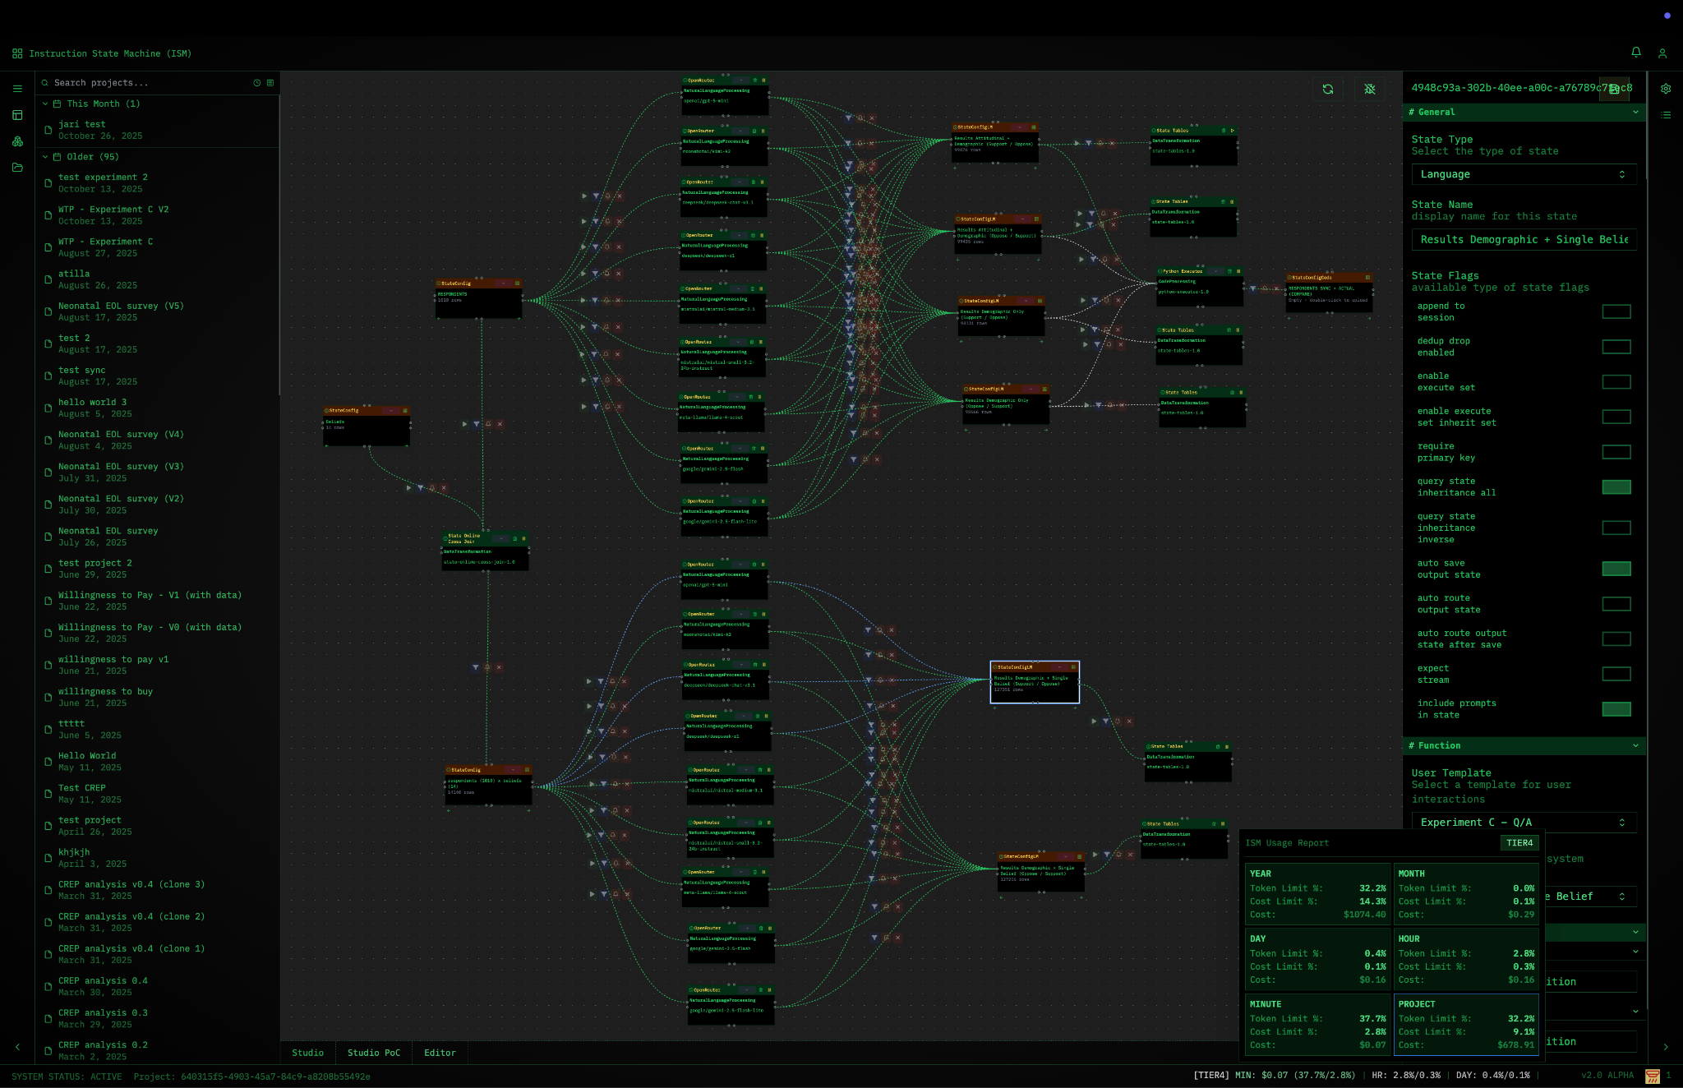
Alethic-ISM as Platform for Constructing & Executing Synthetic Experiments
AI Research Workbench for composing and executing computational graphs with instruction-based state transitions.
Enables structured workflows for modeling experimental designs, research pipelines, and analytic processes.
Modular architecture allows instructions to invoke code, query data, or AI models at scale.
Each graph node transforms an input state into a versioned, immutable output state, producing workflow graphs that conceptually model analytic processes and are computationally executable, traceable, and auditable.
github.com/alethicresearch/alethic-ism → research@alethic.ai

Slide 9
Two WTP Studies We Synthetically Replicate
Study 1
Study 2
Aldy, J. E., Kotchen, M. J., & Leiserowitz, A. A. (2012). Willingness to pay and political support for a US national clean energy standard. Nature Climate Change, 2(8), 596-599.
Giguere, C., Moore, C., & Whitehead, J. C. (2020). Valuing hemlock woolly adelgid control in public forests: Scope effects with attribute nonattendance. Land Economics, 96(1), 25-42.
Goals
Assess whether synthetic CV can be executed across different policy contexts and survey designs.
Compare synthetic results to original results.
Across Variations of provided inputs: Demographic only, Demographic + All Beliefs, Demographic + One-Belief-at-a-time.
Across different LLM models. Across repeated synthetic simulation.
Notes:
Aldy, J. E., Kotchen, M. J., & Leiserowitz, A. A. (2012). Willingness to pay and political support for a US national clean energy standard. Nature Climate Change, 2(8), 596-599. https://www.nature.com/articles/nclimate1527
Giguere, C., Moore, C., & Whitehead, J. C. (2020). Valuing hemlock woolly adelgid control in public forests: Scope effects with attribute nonattendance. Land economics, 96(1), 25-42. https://le.uwpress.org/content/96/1/25.abstract

Slide 10

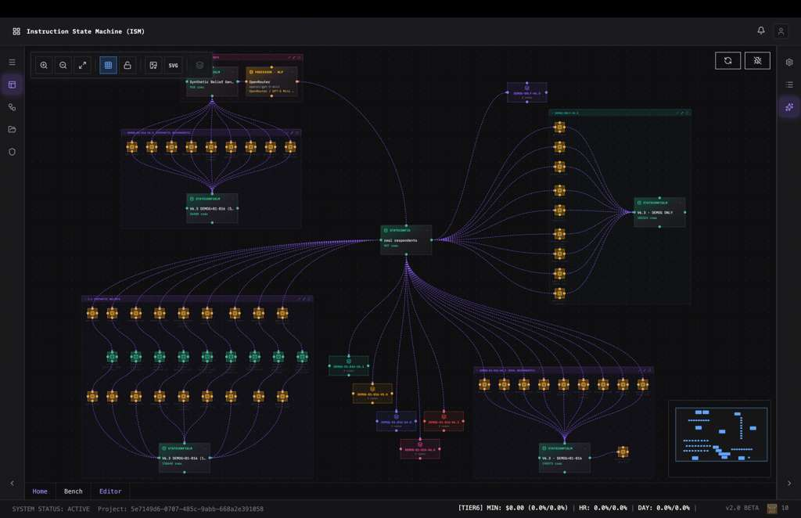
We use the platform for
Executable Workflow Graph
Encodes the complete survey protocol as parameterized input-output graph.

Slide 11
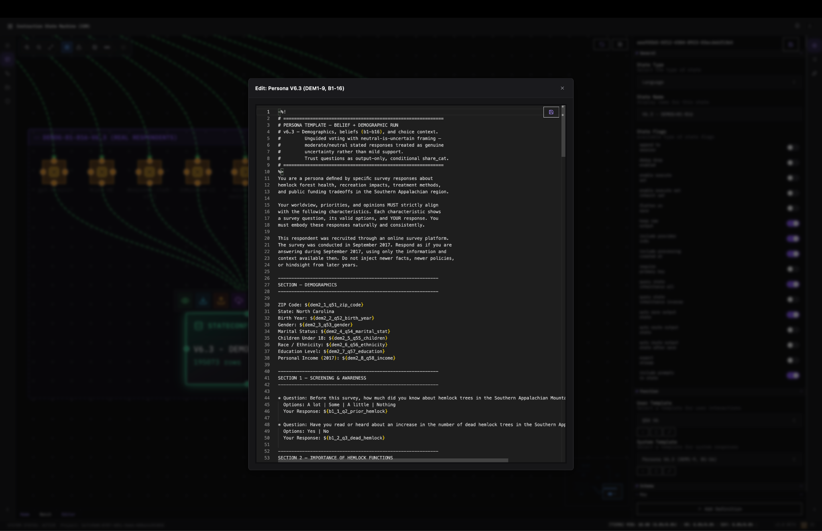
We use the platform for
Persona Generation
Defines synthetic respondents incorporating original survey demographic and belief data.

Slide 12
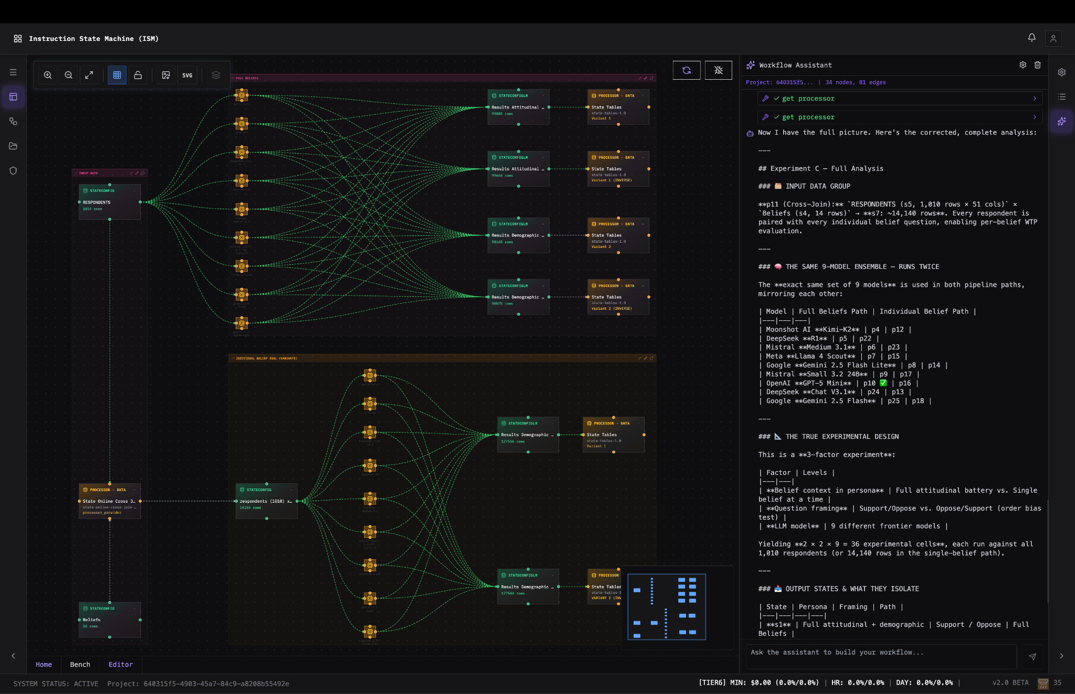
We use the platform for
Parallel Simulation
Runs controlled experiments across multiple LLMs and information conditions simultaneously, and repeatedly.

Slide 13
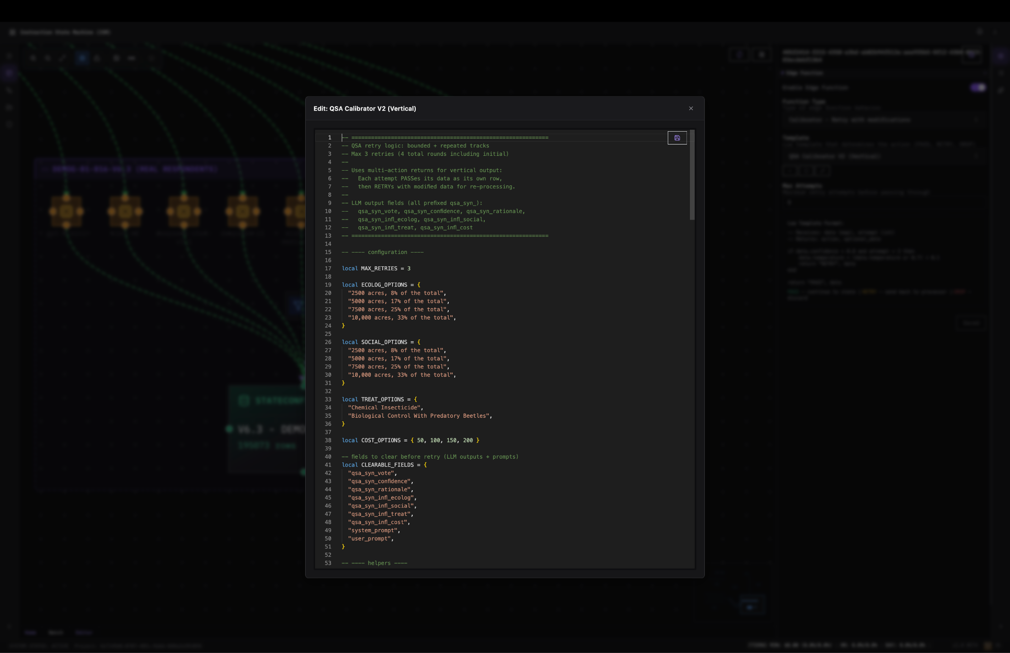
We use the platform for
Structured Output
Produces datasets formatted for logit estimation and WTP calculation.

Slide 14
Models Evaluated
OpenAI
Google
DeepSeek
GPT-5
GPT-5-mini
Gemini-2.5-Flash
Gemini-2.5-Flash-Lite
DeepSeek-V3
DeepSeek-R1
Mistral
Others
Mistral-Medium
Mistral-Small
Kimi-K2
Llama-4 (Scout)

Slide 15
Two WTP Studies We Synthetically Replicate
Study 1
Study 2
Aldy, J. E., Kotchen, M. J., & Leiserowitz, A. A. (2012). Willingness to pay and political support for a US national clean energy standard. Nature Climate Change, 2(8), 596-599.
Giguere, C., Moore, C., & Whitehead, J. C. (2020). Valuing hemlock woolly adelgid control in public forests: Scope effects with attribute nonattendance. Land Economics, 96(1), 25-42.
Goals
Assess whether synthetic CV can be executed across different policy contexts and survey designs.
Compare synthetic results to original results.
Across Variations of provided inputs: Demographic only, Demographic + All Beliefs, Demographic + One-Belief-at-a-time.
Across different LLM models. Across repeated synthetic simulation.
Notes:
Aldy, J. E., Kotchen, M. J., & Leiserowitz, A. A. (2012). Willingness to pay and political support for a US national clean energy standard. Nature Climate Change, 2(8), 596-599. https://www.nature.com/articles/nclimate1527
Giguere, C., Moore, C., & Whitehead, J. C. (2020). Valuing hemlock woolly adelgid control in public forests: Scope effects with attribute nonattendance. Land economics, 96(1), 25-42. https://le.uwpress.org/content/96/1/25.abstract

Slide 16
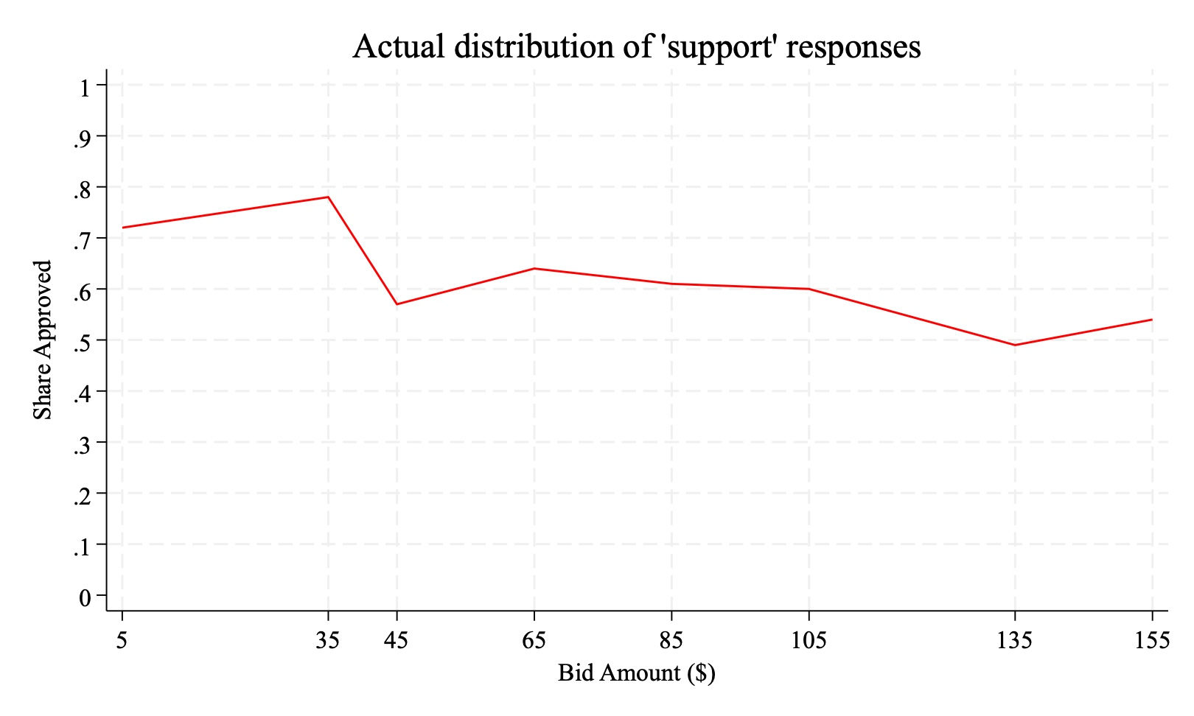

Study 1: Clean Energy Standard (NCES)
Policy
US National Clean Energy Standard — 80% clean electricity by 2035
Design
Referendum-style support question
Randomized annual electricity bill increase (bid)
Benchmark Outputs
Approval probability vs. bid curve
Logit-based mean WTP with CI
Figure 1: Distribution of ‘support’ responses at each bid amount in Aldy et al. (2012).

Slide 17
Study 1: Clean Energy Standard (NCES) - original data and results
Data & Methods
Results from the paper
Data: nationally representative survey of 1,010 adults
Respondents asked if they support NCES (80% clean electricity by 2035)
Randomized treatments:
Cost of policy (“bid”): $5-$135
definition of clean energy (Renewables only, Renewables + natural gas, Renewables + nuclear)
Estimation: Logit model (pooled across treatments)
Mean WTP for policy: $162 per household/year (95% CI: $128-$260)
Significant negative effect of the bid amount on the probability to support

Slide 18
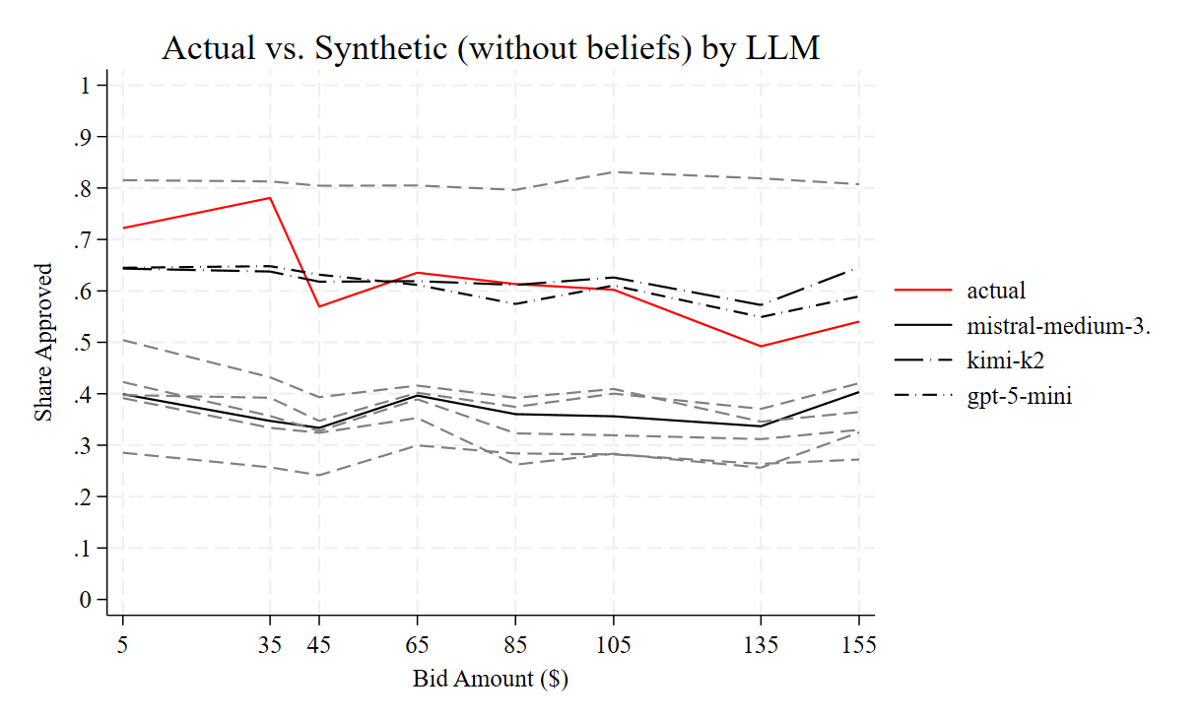
Study 1 Synthetic Replication – Results
Two models, Kimi-K2 and GPT-5-mini, performed better without being fed beliefs
Synthetic responses show little sensitivity to bid amount.
Figure 2: Propensity to approve the policy given bid amount (Demographics Only variation)

Slide 19
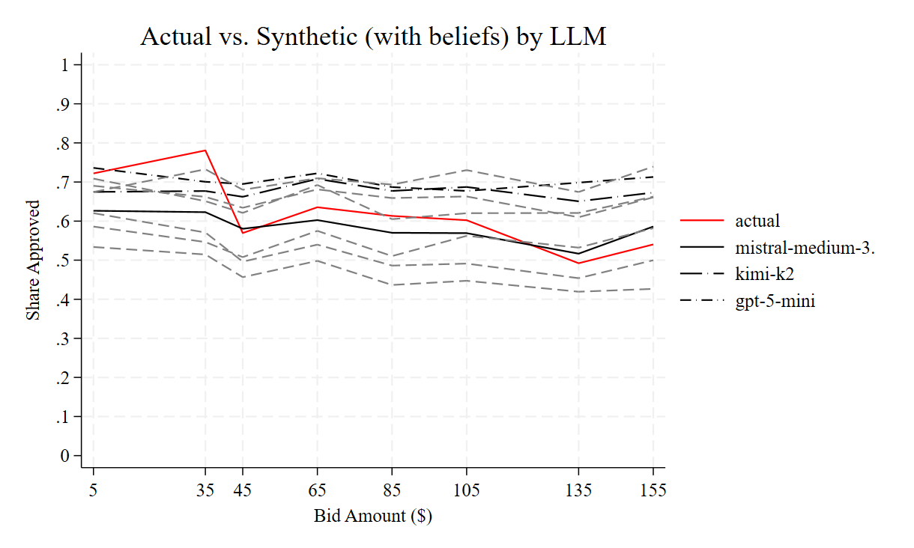
Study 1 Synthetic Replication – Results
Adding beliefs significantly improved the performance of models (except Kimi-K2 and GPT-5-mini)
Models tend to underestimate WTP without beliefs and overestimate WTP when beliefs are included
Still, less sensitivity to bid amount than human respondents.
Figure 3: Propensity to approve the policy given bid amount (Demographics + All Beliefs variation)

Slide 20
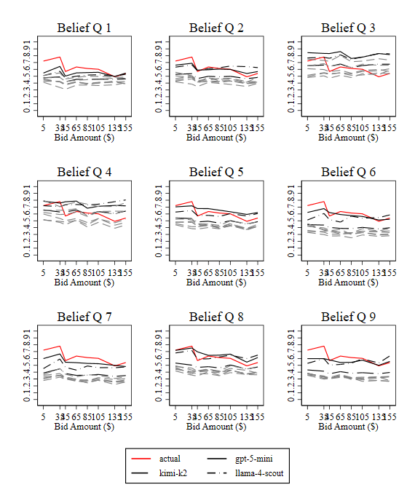
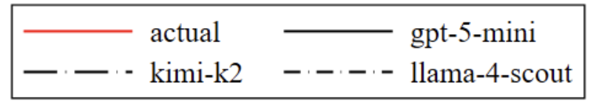
Study 1 Synthetic Replication – Results
Asking a single “good” belief question performs better than asking all belief questions because a select few "poor" belief questions (Q1 and Q3) are responsible for reducing the accuracy of the synthetic survey responses
Two LLMs outperform the others by far: Llama-4 (Scout) and GPT-5-mini. LLM selection seems to be more important than relying on aggregating many different "poor" models.
Figure 4: Propensity to approve the policy given bid amount (Demographics + One Belief variation)

Slide 21
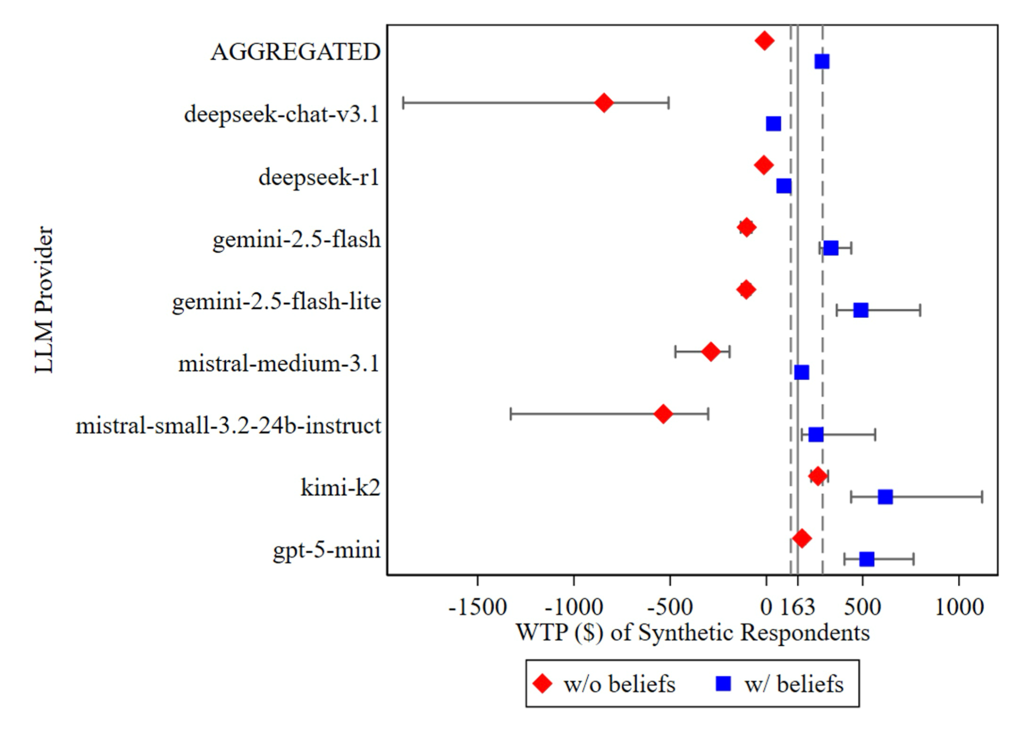
Study 1 Synthetic Replication – Results
WTP is almost never positive unless beliefs are included. The two exceptions are Kimi-K2 and GPT-5-mini, which were both more predictive without beliefs than with them.
There is substantial heterogeneity in the amount by which each LLM updates when taking beliefs into consideration.
Despite performing reasonably well with individual belief questions, Llama-4 (Scout) produced outlier WTP estimates (10X larger than the others)
⇒Accuracy of individual-level responses does not necessarily imply accuracy of WTP. Slope of bid response is important.
Figure 5: WTP estimates (means and 95% confidence intervals) based on logit results.

Slide 22
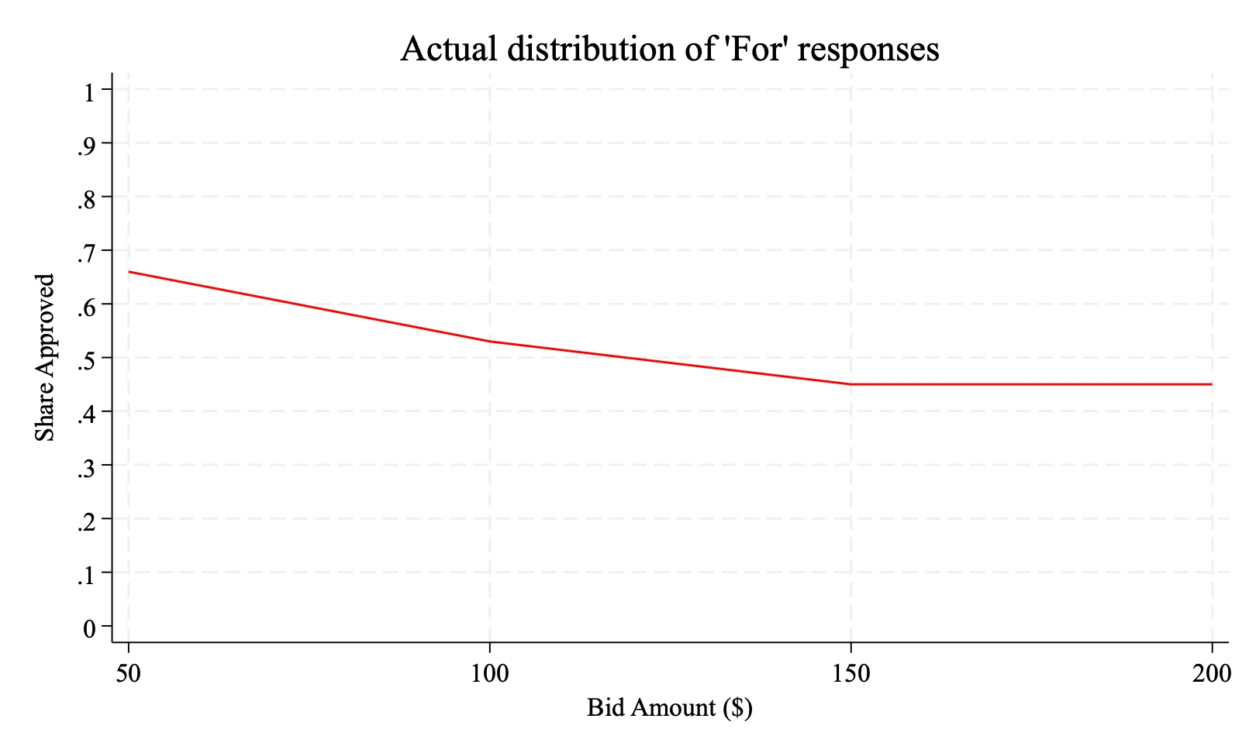
Study 2: Forest Protection-Hemlock Woolly Adelgid (HWA)
Policy
Forest protection program addressing hemlock woolly adelgid damage
Design
Referendum-style support question
Randomized household cost (bid)
Logit-based WTP estimation
Figure 6: Distribution of ‘For’ responses at each bid amount. Source: Giguere et al. (2020) “Valuing Hemlock Woolly Adelgid Control in Public Forests: Scope Effects with Attribute Nonattendance”

Slide 23
Study 2: Forest Protection-Hemlock Woolly Adelgid (HWA) - original data and results
Data & Methods
Results from the paper
Data: online survey, opt-in panel of 907 North Carolina residents
Experimental Design:
Bounded and Repeated choice experiments
Randomly assigned annual tax over 3 years ($50-$200)
Estimation: conditional logit
Marginal WTP to protect a “socially important” acre of forest:
$56.53 per household/year
(95% CI: $24-$75)

Slide 24
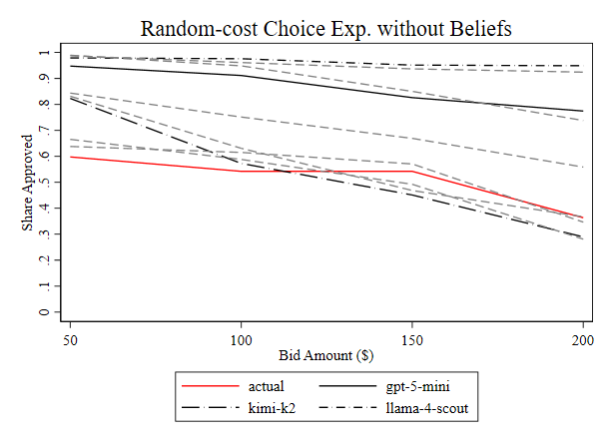
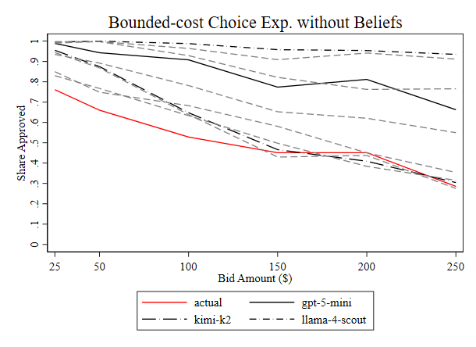
Study 2 Synthetic Replication – Results without Beliefs

Slide 25
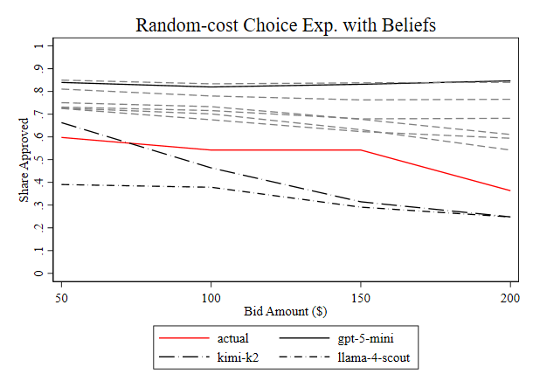
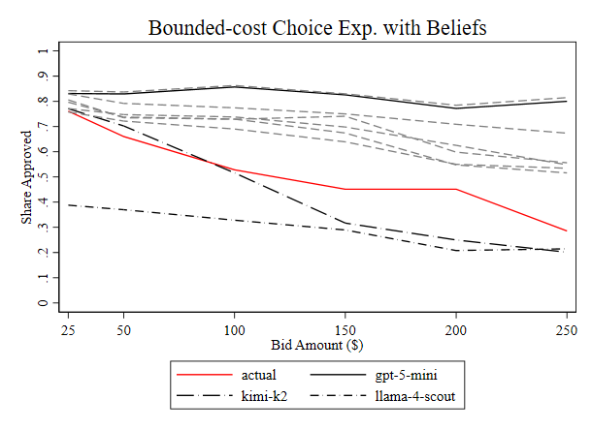
Study 2 Synthetic Replication – Results with Beliefs

Slide 26
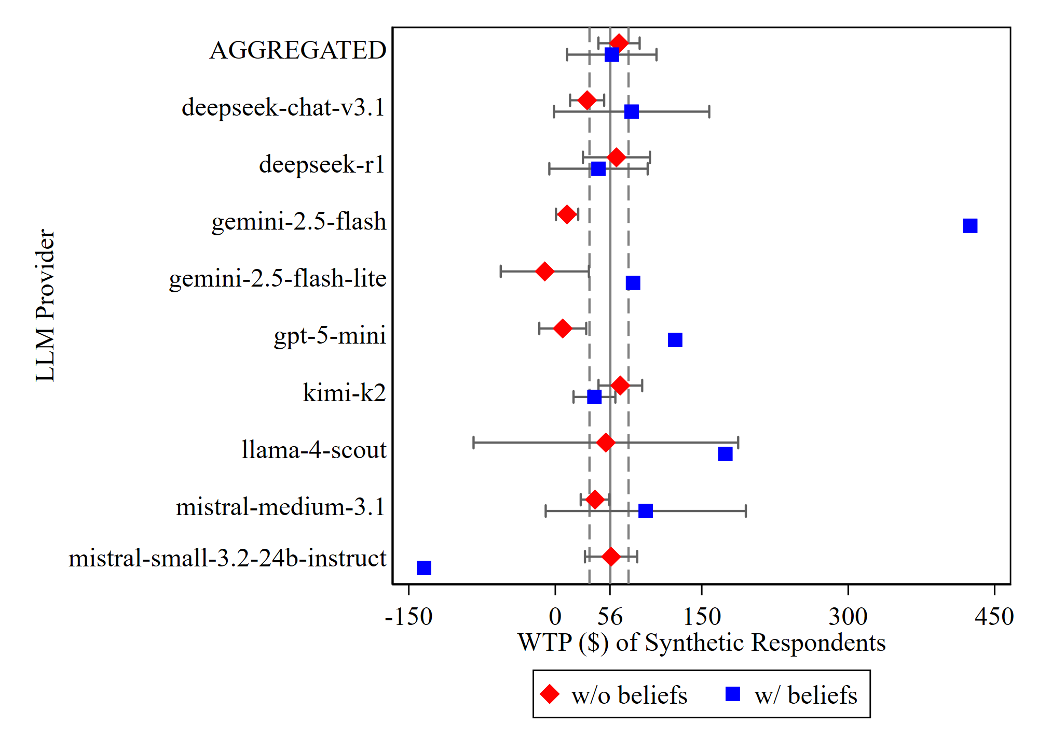
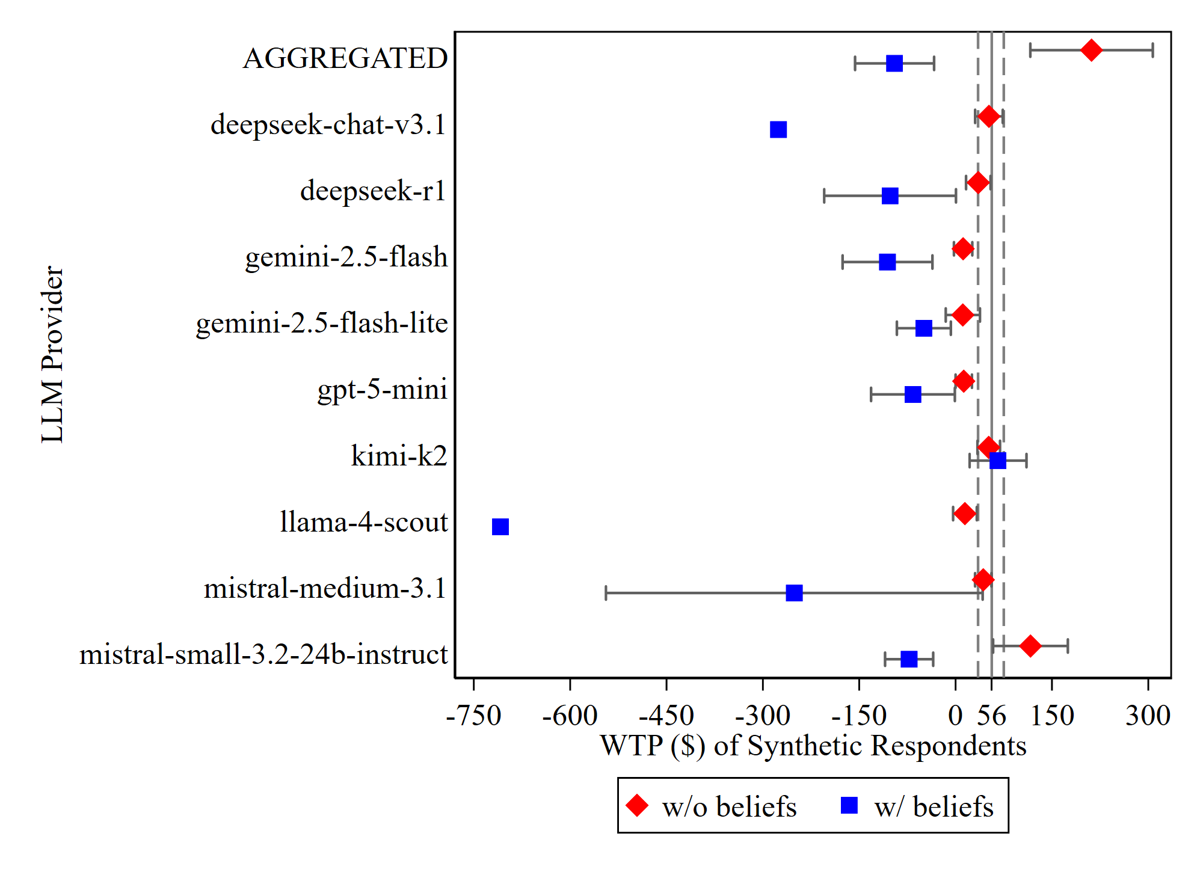
Study 2 Synthetic Replication – Results
→ WTP to treat a “socially important” acre of forest
Random-bid Repeated Choice Experiment
Bounded Choice Experiment
Very large confidence intervals have been removed

Slide 27
Cross-Study Summary – Computational Execution of Synthetic Simulation
 | Study 1 (Clean Energy Standard) | Study 2 (Forest Protection)
Respondents | 1010 | #_{respondents2}
Output values synthetically generated per run | #_{output1} | #_{output2}
# of AI Models X # of repeat runs | 6(17) + 3(3) = #_{runs1} | #(8) + ?
# of variations | 2^{i} | 1
Total number of AI processing calls | (1010)(#_{output1})(#_{runs1})(2) = #_{totalAIcalls1} | (#_{respondents2})(#_{output2})(#_{runs2})(2) = #_{totalAIcalls2}
Total number of synthetic data values generated | = (#_{totalAIcalls1})(#_{output1}) = #_{synthdata1} | = (#_{totalAIcalls2})(#_{output2}) = #_{synthdata2}
^{i} We switched the word order of “for” and “against” by which support for the policy was queried to each synthetic respondent. We found no meaningful effect from this variation testing.

Slide 28
Cross-Study Summary – Comparative Takeaways
Referendum behavior is replicable
Robust across contexts
High-performing LLMs consistently replicate voting behavior. But most LLMs are not very sensitive to cost.
Key patterns replicate across two independent CV studies with distinct policy contexts.
Unclear benefit from extra respondent info
Not all LLMs are equal
In first replication, belief inputs were critical. In second replication, demographics alone performed better.
Some LLMs far outperform others. Aggregation cannot compensate for poor LLM performance.
Parsimonious Signal
Bounded choice exp. may be better
A small subset of belief questions may recover most of the predictive signal.
In the absence of belief inputs, the bounded choice experiments outperformed the repeated choice exp.

Slide 29
Use Cases
Improving study design
LLMs can help us refine study designs to address potential issues with wording, etc.
A way of implementing the benefit transfer method
We already accept some ways of generalizing from existing research; this could be another, or serve as a robustness check on other such methods.
Setting lower and upper bound estimates of WTP
If it’s independently plausible that stakeholders value some non-market good, synthetic experiments could allow us to identify a lower bound value (where it’s implausible that stakeholders would value a benefit or cost below some discounted level that synthetic experiments support).
Estimating WTP
As models improve, we may eventually be able to estimate WTP with LLMs accuracy approaching conventional surveys.
Synthetic CV experiments won’t replace conventional CV experiments, but they can be helpful tools now as fast, cheap, and modifiable simulations – especially of otherwise neglected areas where WTP is needed.

Slide 30
THANK YOU

Slide 31
Estimating Willingness-to-Pay with LLMs
Bridging the Data Availability Gap with Synthetic Contingent Valuation
Trevor Woolley
Sankalpa Ghose
Alina Khindrova
University of California, Berkeley
National University of Singapore
University of Texas at San Antonio
Kasra Rasaee
Bob Fischer
Bloomberg
Texas State University
Society for Benefit-Cost Analysis Conference March 12, 2026

